Slide 1
Implementation of the Cooley-Tukey Fast Fourier Transform on a 16-bit Microcontroller
Slides by Greg Larmore
Presented on 10/24/12 by Greg Larmore

Slide 2

About the Presenter
Attends Rose-Hulman Institute of Technology
Bachelor of Science Electrical Engineering – May 2013
Previous experience in low level embedded software and firmware development and code maintenance

Slide 3
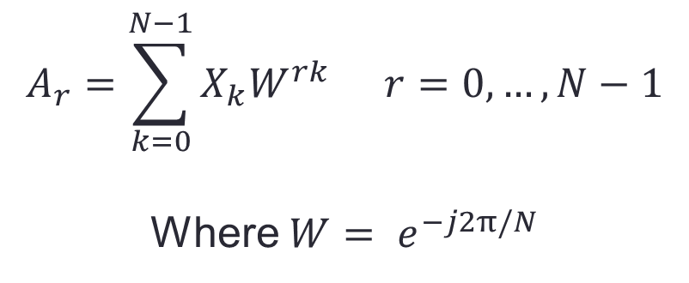
The Fast Fourier Transform (FFT)
Cooley and Tukey reported in 1965 a method for computing Fourier coefficients which required much less computational effort than the traditional discrete Fourier transform (DFT):
$$A_{r}=\sum_{k=0}^{N−1}{X_{k}W^{rk}} r=0, …, N−1$$
Where $W= e^{−j2π/N}$

Slide 4
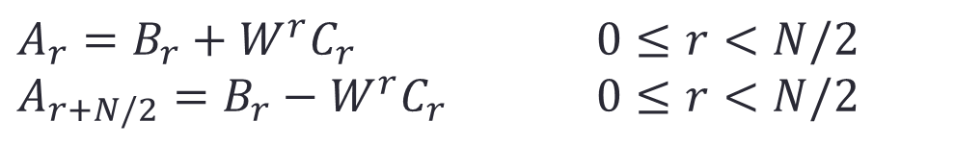
The Cooley-Tukey FFT
$$Let Y_{k}= X_{2k} and Z_{k}= X_{2k+1} k=0, 1, …,\frac{N}{2}−1$$
$A_{r}=B_{r}+W^{r}C_{r}$ $0≤r<N/2$
$A_{r+N/2}=B_{r}−W^{r}C_{r}$ $0≤r<N/2$
$$Where B_{r} is the Fourier transform of Y_{k}$$
$$and C_{r} is the Fourier transform of Z_{k}$$
This reduction can continue as long as N is divisible by 2.
This method became known as the decimation in time (radix-2) fast Fourier transform
Notes:
O(Nlog2(N)) performance instead of O(N^2)

Slide 5





























Decimation in Time FFT Flow Graph
000 $X_{0}$
$A_{0}$000
$$W^{0}$$
100 $X_{4}$
$$−1$$
$A_{1}$001
$$W^{0}$$
010 $X_{2}$
$$−1$$
$A_{2}$010
$$W^{0}$$
$$W^{2}$$
110 $X_{6}$
$$−1$$
$$−1$$
$A_{3}$011
$$W^{0}$$
001 $X_{1}$
$$−1$$
$A_{4}$100
$$W^{0}$$
$$W^{1}$$
101 $X_{5}$
$$−1$$
$$−1$$
$A_{5}$101
$$W^{2}$$
$$W^{2}$$
011 $X_{3}$
$$−1$$
$$−1$$
$A_{6}$110
$$W^{0}$$
$$W^{2}$$
$$W^{3}$$
111 $X_{7}$
$$−1$$
$$−1$$
$$−1$$
$A_{7}$111

Slide 6
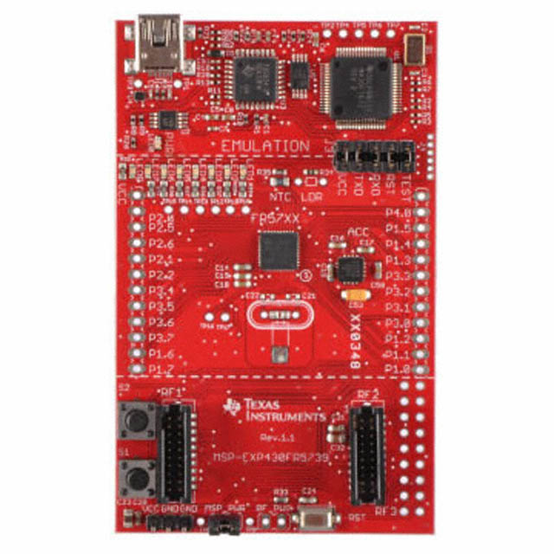
The Hardware
MSP430FR5739 Specifications
16-bit RISC architecture with up to 24MHz clock
16kB FRAM and 1kB SRAM
32-bit hardware multiplier
Ultra-low power operation
81.4µA/MHz active mode
6.3µA standby mode
1.5µA real-time clock
0.32µA shutdown
MSP-EXP430FR5739 experimenter board

Slide 7
Firmware Implementation
The firmware to implement the Cooley-Tukey algorithm was written in C++ and uses Q1.15 (signed) fixed point arithmetic accelerated by the 32-bit hardware multiplier.
void FFT(complex<Q1_15> *data, uint8_t inv);
Q1_15& operator*=(const Q1_15 &x) {
//Q1.15 fixed point multiply (hardware)
MPYS = _full;
OP2 = x._full;
_full = RESHI;
return *this;
};

Slide 8
Firmware Implementation
Twiddle factors for the forward and inverse transforms as well as bit reversal tables are stored as constant arrays based on a predefined length
#if (LENGTH == 4)
const uint16_t BRT[] = {0, 2, 1, 3};
const uint16_t TWIDD[] = {0x7FFF, 0x0000, 0x0000, 0x8000};
const uint16_t INV_TWIDD[] = {0x7FFF, 0x0000, 0x0000, 0x7FFF};
#elif (LENGTH == 8)
const uint16_t BRT[] = {0, 4, 2, 6, 1, 5, 3, 7};
const uint16_t TWIDD[] = {0x7FFF, 0x0000, 0x5A82, 0xA57F, 0x0000, 0x8000, 0xA57F, 0xA57F};
const uint16_t INV_TWIDD[] = {0x7FFF, 0x0000, 0x5A82, 0x5A82, 0x0000, 0x7FFF, 0xA57F, 0x5A82};

Slide 9
FFT Algorithm Implementation
1 - Bit reverse input
for (i = 0; i < LENGTH; i++) {
j = BRT[i];
if (j < i) {
temp = data[i];
data[i] = data[j];
data[j] = temp;
}
}
2 - Perform radix-2 butterflies
for (i = 0; i < LENGTH; i += 2) {
uint16_t a = i;
uint16_t b = i + 1;
temp = data[a] - data[b];
data[a] += data[b];
data[b] = temp;
}

Slide 10
FFT Algorithm Implementation
3 - Perform larger butterflies with appropriate twiddle factors
for (n = 2, m = HALF_LENGTH; n < LENGTH; n <<= 1, m >>= 1) {
for (i = 0; i < LENGTH; i += n << 1) {
for (j = 0, k = 0; j < n; j++, k += m) {
uint16_t a = i + j;
uint16_t b = a + n;

Slide 11
Decimation in Time FFT Flow Graph
000 $X_{0}$
$A_{0}$000
$$W^{0}$$
100 $X_{4}$
$$−1$$
$A_{1}$001
$$W^{0}$$
010 $X_{2}$
$$−1$$
$A_{2}$010
$$W^{0}$$
$$W^{2}$$
110 $X_{6}$
$$−1$$
$$−1$$
$A_{3}$011
$$W^{0}$$
001 $X_{1}$
$$−1$$
$A_{4}$100
$$W^{0}$$
$$W^{1}$$
101 $X_{5}$
$$−1$$
$$−1$$
$A_{5}$101
$$W^{2}$$
$$W^{2}$$
011 $X_{3}$
$$−1$$
$$−1$$
$A_{6}$110
$$W^{0}$$
$$W^{2}$$
$$W^{3}$$
111 $X_{7}$
$$−1$$
$$−1$$
$$−1$$
$A_{7}$111

Slide 12
FFT Algorithm Implementation
switch (k) {
case 0: //This twiddle is 1 + j0
twidd = data[b];
break;
case HALF_LENGTH: //This twiddle is 0 - j1
twidd.real(data[b].imag());
twidd.imag(-data[b].real());
break;
default:
twidd.real(TWIDD[k]);
twidd.imag(TWIDD[k+1]);
twidd *= data[b];
break;
}
data[b] = data[a] - twidd;
data[a] += twidd;

Slide 13
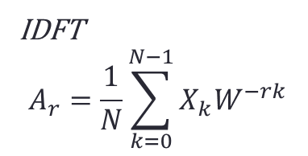
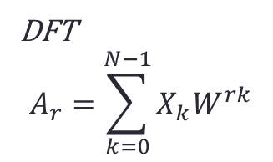
FFT Algorithm Implementation
4 - Divide by N for inverse fast Fourier transform
i = HALF_LENGTH;
n = 0;
while (i != 0) {
i >>= 1;
n++;
}
for (i = 0; i < LENGTH; i++) {
data[i].real(Q1_15(data[i].real().full()>>n));
data[i].imag(Q1_15(data[i].imag().full()>>n));
}
DFT
$$A_{r}=\sum_{k=0}^{N−1}{X_{k}W^{rk}}$$
IDFT
$$A_{r}=\frac{1}{N}\sum_{k=0}^{N−1}{X_{k}W^{−rk}}$$

Slide 14
Results
Running at the default 1MHz, 1 FFT was completed in 4,723 cycles when N=8 (4.723ms)
There were some mismatches between the original and the recreated.
These mismatches seem to be due to rounding error from the fixed point arithmetic.

Slide 15
Conclusions
While the FFT is an effective tool for embedded DSP systems, it is not well suited for a 16-bit microcontroller like the MSP430.
Why?
No floating point arithmetic unit
Insufficient clock speed
Limited memory
16-bit limitation

Slide 16
Questions?

